Slide 1
WAREHOUSE MANAGEMENT SYSTEM
JORDAN GEORGE ABRAHAM
RA1931241010107
III BCA- C

Slide 2
ABSTRACT
This project examines Warehouse Management System (WMS) practices and their effects on operations. This study analyses the relationship between adoption of WMS to its impacts on business performance and competitive advantage of a regional distribution centre.
The Warehouse Management System is a real-time warehouse database capable of handling large inventories of an organization. This can be used to track the inventory of a single store, or to manage the distribution of stock between several stores of a larger franchise.

Slide 3
INTRODUCTION
Globalization and competitive pressures have heightened the impetus for strategic use of MIS. More specifically, Warehouse Management System (WMS) designed to introduce improvement into every aspect of a company’s warehouse operations offers an organized approach to manage efficiency. QR code data collection solutions for warehouse management system provides powerful and flexible automatic identification system that connects the shop floor to the enterprise software. By integrating advanced radio frequency and QR coding technologies with core warehousing functionality, WMS provides comprehensive fulfillment centre and warehouse management, including receiving, stocking, picking and related warehouse tasks.

Slide 4
ANALYSIS AND REQUIREMENTS
Hardware Requirements
64 bit versions of Windows 8 or above, macOS 10.14 or above, Linux that supports Gnome, KDE or Unity DE
4gb of free RAM, any modern CPU, more than 5gb of disk space display resolution: 1024 x 768
Camera or Qr Code Scanner: A camera is an optical instrument that captures a visual image. At a basic level, cameras consist of sealed boxes (the camera body), with a small hole (the aperture) that allows light through to capture an image on a light-sensitive surface

Slide 5
Software Requirements
Pycharm: It is an integrated development environment (IDE) used in computer programming, specifically for the Python programming language. It is developed by the Czech company JetBrains (formerly known as IntelliJ). It provides code analysis, a graphical debugger, an integrated unit tester, integration with version control systems (VCSes), and supports web development with Django.PyCharm is cross-platform, with Windows, macOS and Linux versions.

Slide 6
FEATURES OF PYCHARM
Coding assistance and analysis, with code completion, syntax and error highlighting, linter integration, and quick fixes.
Integrated Python debugger
Project and code navigation: specialized project views, file structure views and quick jumping between files, classes, methods and usages.

Slide 7
SYSTEM ANALYSIS
Existing System
Current warehouse management all work done using paper work. All files record kept on paper file. In warehouse management its very complicated to keep record and get data fast.
Dealing with big data is very tough. Maintaining all record in specific manner is not possible.
Dealing with billing system have so much problem, Because no idea about how much product stock in wear house. To calculate it manually is so much difficult.
All data analysis work is done manually so required time is more.

Slide 8
Proposed System
In our proposed system we proposed four module, the system has no manual work. Its has also QR code scanner so data recording becomes easy.
Qr code Scanner: This function is used to scan the qr code for update and entry of the data.
Generate QR code: Any Product that enters in the warehouse, we stick the QR code, this qr code has information related to product.
Product details: Product details have information related to all product data. We can easily search data.
Employee details : Employee details have store information related to employee when any employee register on this system they show data in Employee details.

Slide 9
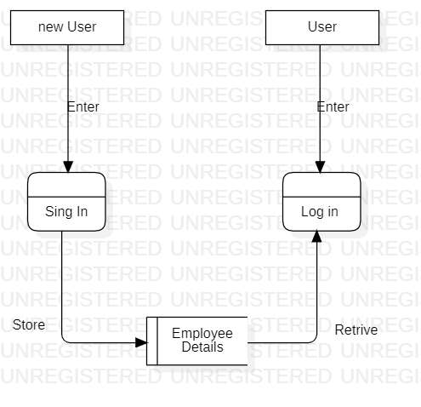
DESIGN
Data Flow Diagram
Home Page DFD Diagram
A data flow diagram (DFD) maps out the flow of information for any process or system. It uses defined symbols like rectangles, circles and arrows, plus short text labels, to show data inputs, outputs, storage points and the routes between each destination.
Data flowcharts can range from simple, even hand-drawn process overviews, to in-depth, multi-level DFDs that dig progressively deeper into how the data is handled.

Slide 10
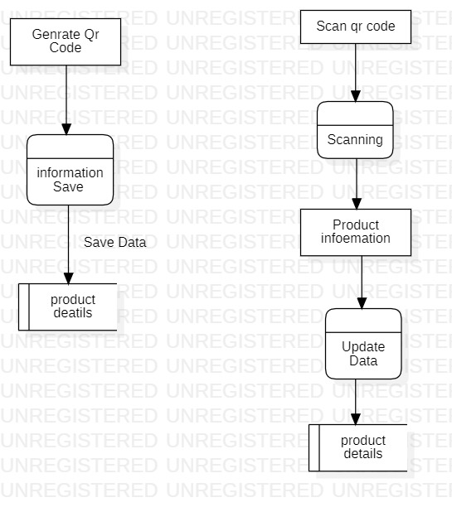
Product Details 0 Level DFDs
Its Diagram shows that when we generate qr code for any product the data is stored in the database and this data is use for analysis of record of product.

Slide 11
Product Details 1 Level DFDs
When any Product qr code is scanned from the scanner option you will get data about this product. In this data we can update information. This information updates in the database also.

Slide 12
UML Diagrams
A UML diagram is the graphical presentation of a set of elements, most often rendered as a connected graph of vertices and arcs. You draw diagram to visualize a system from different perspective, so a diagram is a projection into a system. For all but most trivial systems, a diagram represents an elided view of the elements that make up a system. The same element may appear in all diagrams, only a few diagrams, or in no diagrams at all.

Slide 13
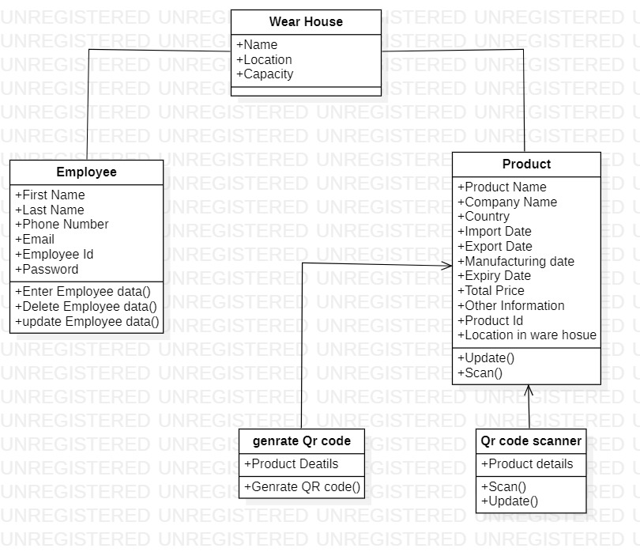
Class Diagram
The Class diagram is a graphical notation used to construct and visualize object oriented systems. A class diagram in the Unified Modeling Language (UML) is a type of static structure diagram that describes the structure of a system

Slide 14
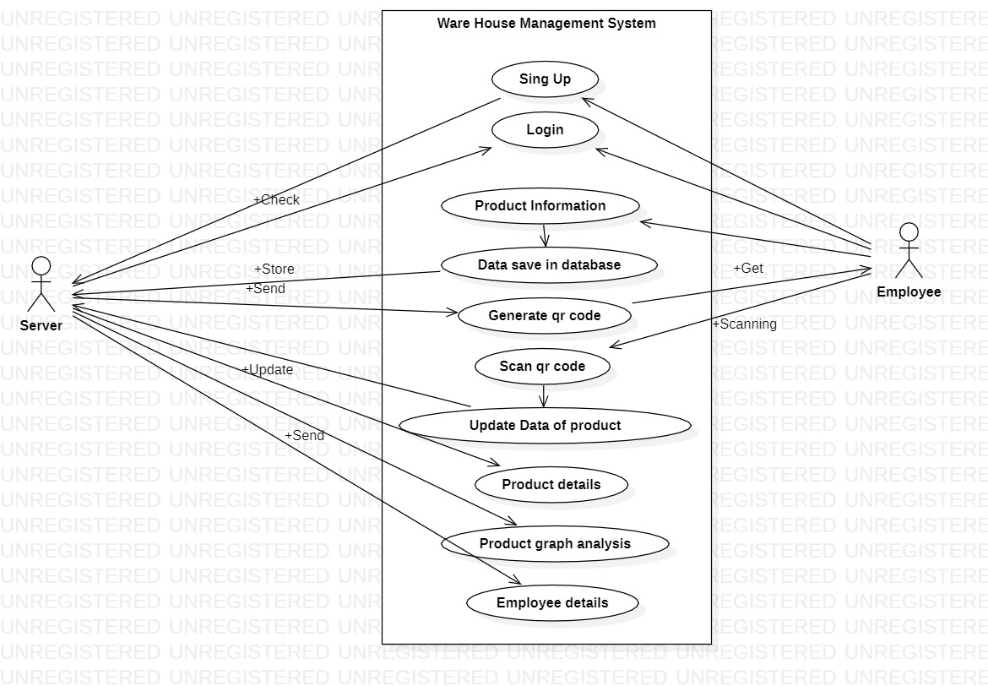
Use Case Diagram
A use case diagram in the Unified Modeling Language (UML) is a type of behavioral diagram defined by and created from a use-case analysis. Its purpose is to present a graphical overview of the functionality provided by a system in terms of actors, their goals (represented as use cases), and any dependencies between those use cases.

Slide 15
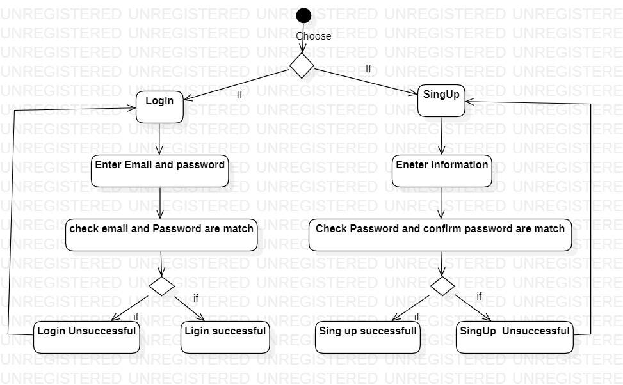
Activity Diagram of Login/ Signup Page
We use Activity Diagrams to illustrate the flow of control in a system and refer to the steps involved in the execution of a use case. We model sequential and concurrent activities using activity diagrams.

Slide 16
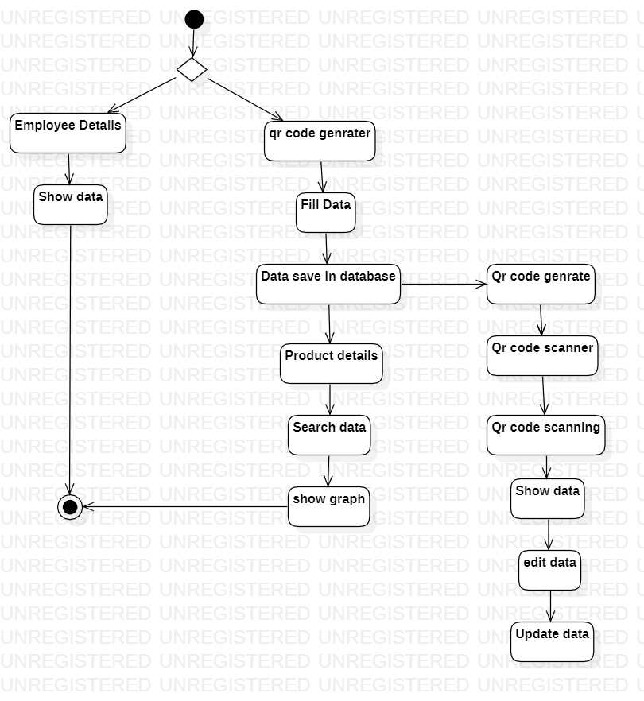
Activity Diagram of product Details

Slide 17
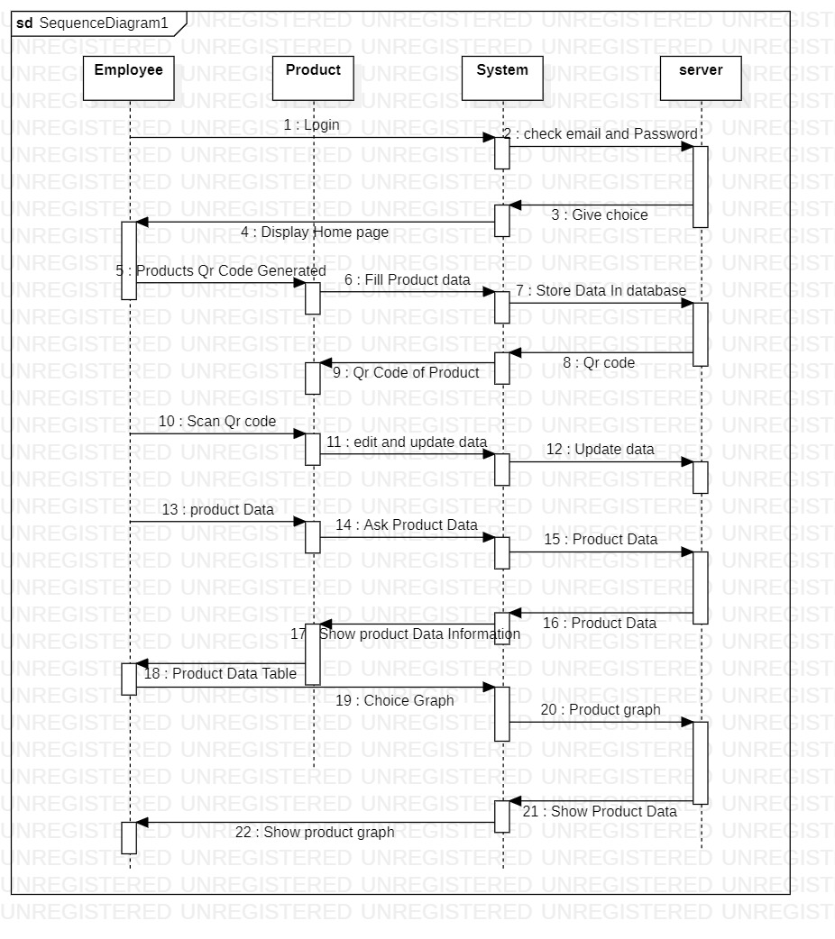
Sequence diagram
Sequence diagrams are a popular dynamic modeling solution in UML because they specifically focus on lifelines, or the processes and objects that live simultaneously, and the messages exchanged between them to perform a function before the lifeline ends.

Slide 18
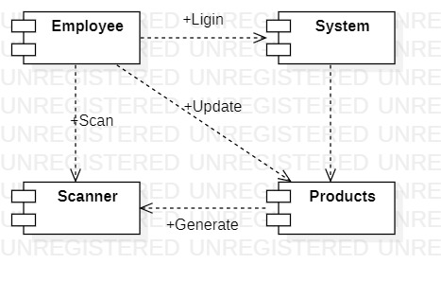
Component Diagram
UML Component diagrams are used in modeling the physical aspects of object-oriented systems that are used for visualizing, specifying, and documenting component-based systems.

Slide 19
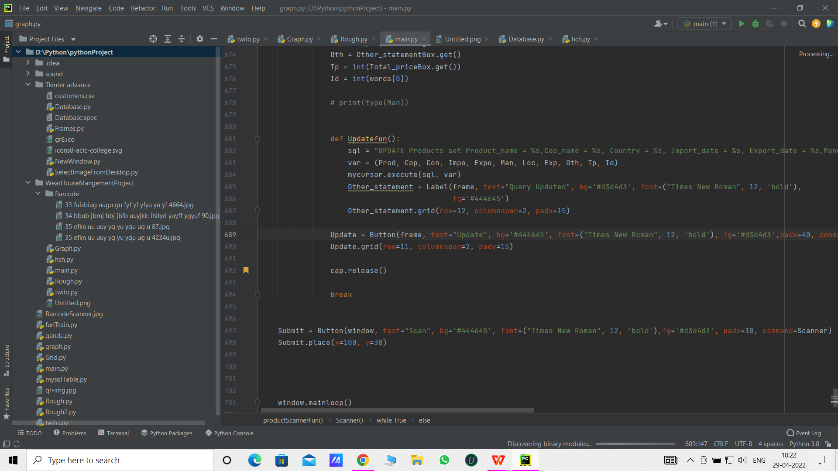
IMPLEMENTATION
Coding
Python is a high-level, interpreted, general-purpose programming language. Its design philosophy emphasizes code readability with the use of significant indentation. Its language constructs and object-oriented approach aim to help programmers write clear, logical code for small- and large-scale projects.

Slide 20
TESTING
We test the I/O errors we check whether data entered is displayed sucessfully.
We check whether the camera is able to scan the qrcode, whether the system is able to generate qrcode and update the product details.
In the given sheet we can see the testing of employee login details.
We test all the possible methods to find if any error occurs.
Employee email | Employee password | Result
jordan@gmail.com | 12345 | Pass
darshan@gmail.com | 09876 | Pass
Bhavesh@gmail.com | 24680 | Pass

Slide 21
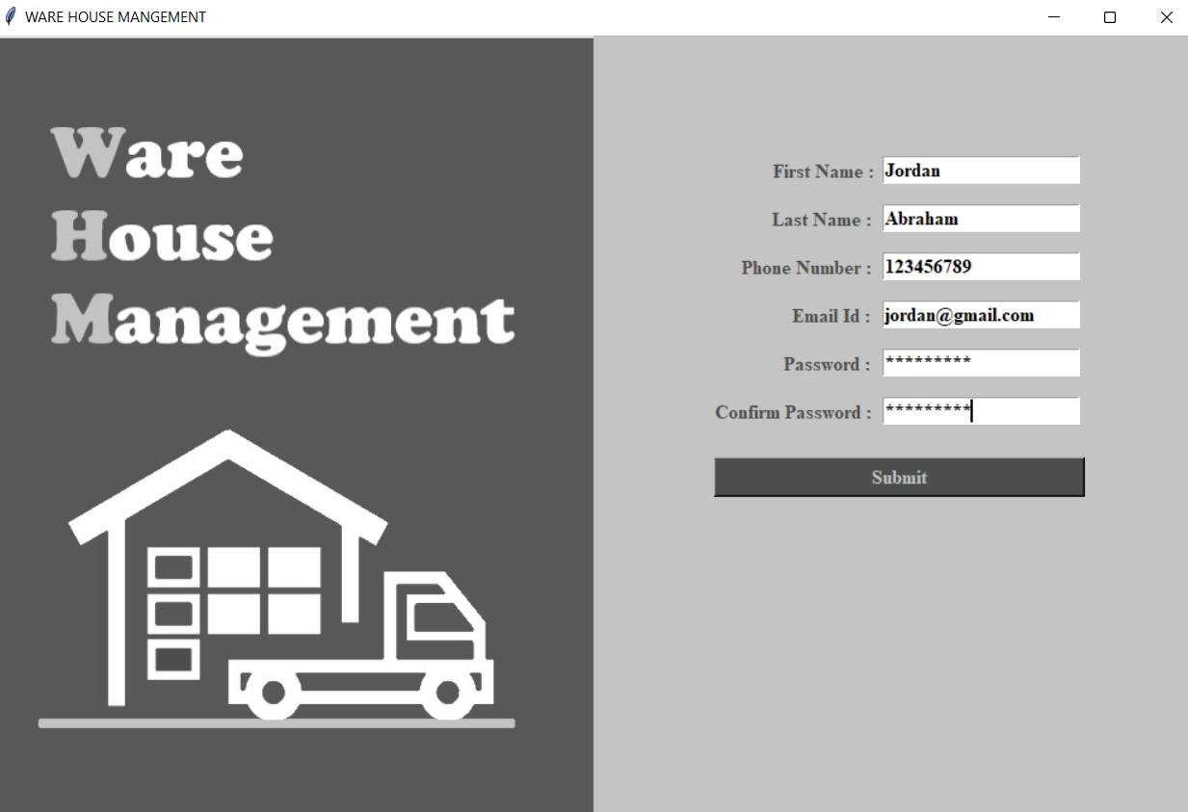
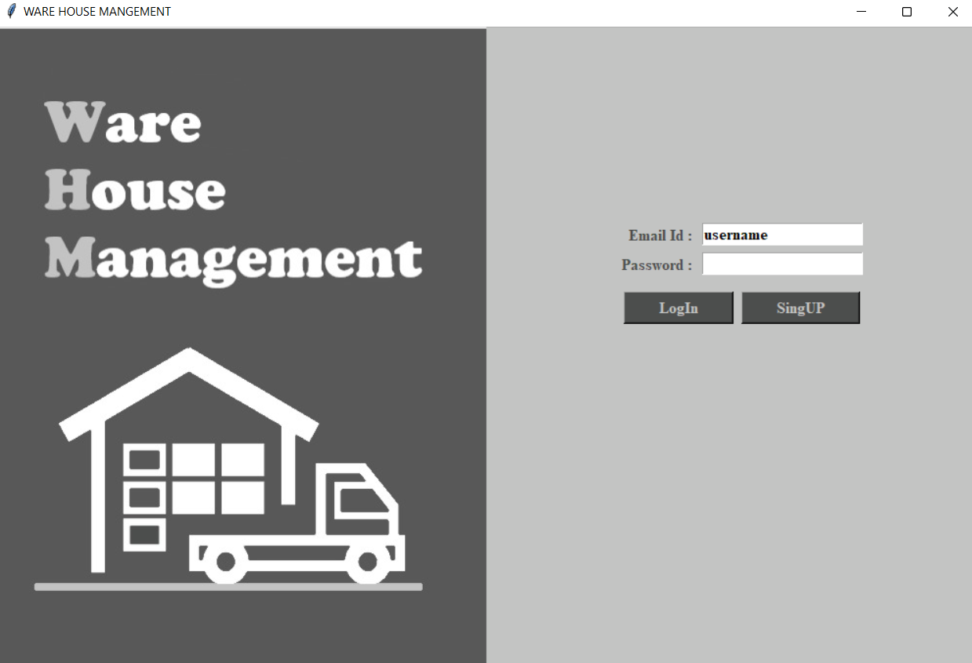
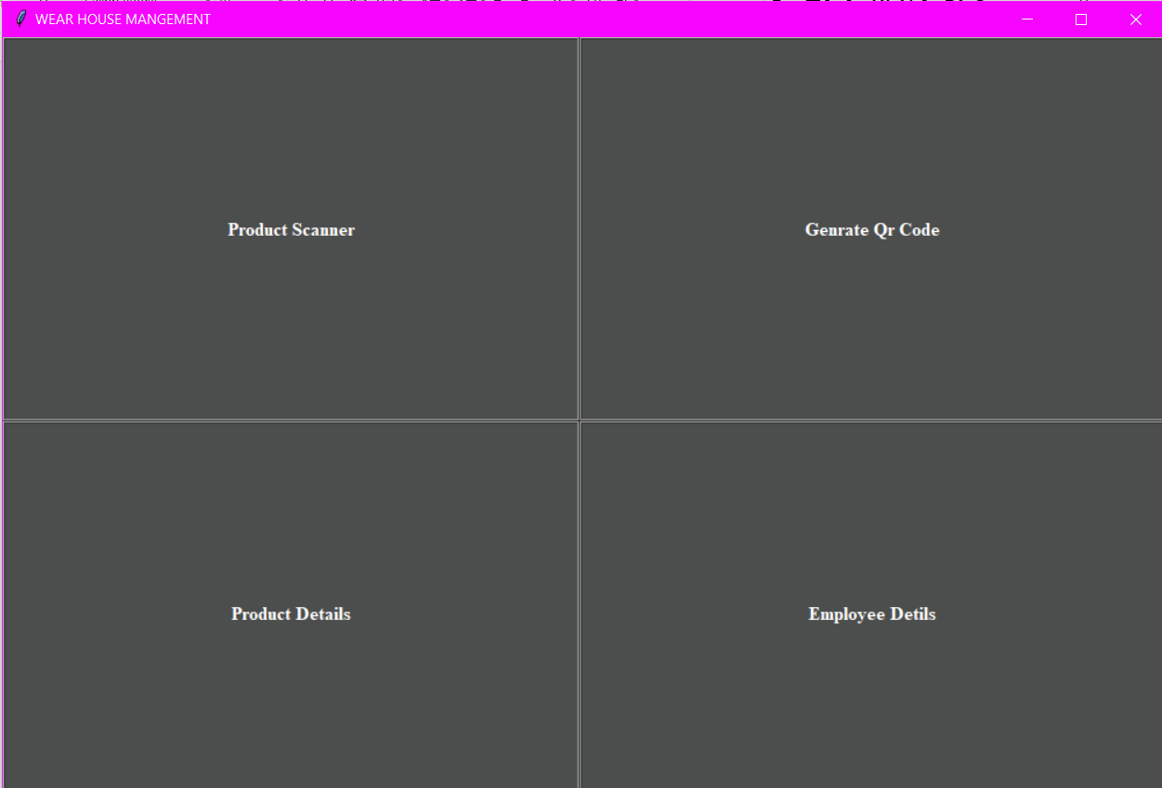
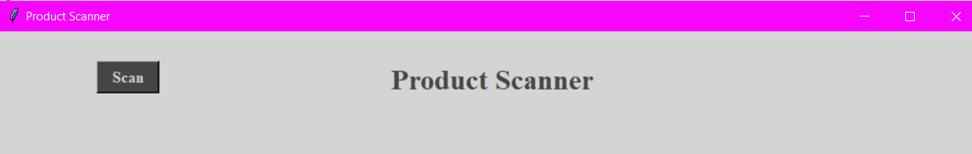
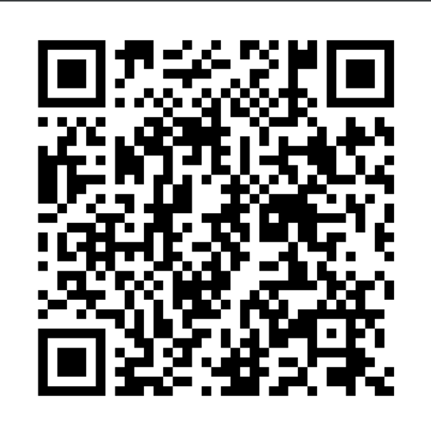
OUTPUT SCREENS

Slide 22
CONCLUSION
In warehousing management, existing transaction data is required for accuracy and speed in processing, using a system. Warehouse management system is an essential replacement for a manual management system. The main purpose of automating the warehouse system is to control the movement and storage of the products, together with the benefit of enhanced security and quicker handling.

Slide 23
FUTURE ENHANCEMENTS
1.Its new future work is in single window change with frame
2.Add transport system data also.
3.More attractive icon use instead of name.
4.Searching bar and table also to be more fast and to be able to delete old searches.
5.In employee details, to give option for deleting and updation.

Slide 24
THANK YOU

